Slide 1
Enrollment to Authentication Client and Station Overview UIDAI
Sanjay Jain
Jagadish

Slide 2
Agenda
Overview
Aaadhaar Enrollment Station – Sneak Preview
Unveiling the Aaadhaar Enrollment Client Software
Aaadhar Authentication Overview
Questions

Slide 3
Model Enrollment Station Objectives
Objective
Create a test bed to evolve best practices.
Output- Model Enrollment Station Specifications.
Evolve designs for various enrollment requirements.
Evolve Efficiency Improvements-
Standardizing Components
Layout, Ergonomics, Environmental Conditions
Power Requirements.
Improving Mobility – Through a exclusively designed Kit
Optimized Packaging leading to Ready to Ship branded casing- Ready for Unpack Or In Box Operation
Improvements to suite different requirements.

Slide 4
Station Overview
Requirements of a Enrollment Station
Appropriately lit room
A Table( minimum of 2’x3’)
Regulated Power supply(minimum of 4 power outlets)
Seating for resident and officer and assistant.
Seating for Waiting residents.

Slide 5
Enrollment Set up Overview
Components of Enrollment station
PC (laptop, Desktop),
Camera for Face photograph.
Fingerprint Slab scanner
Iris Camera
Laserjet Printer
Additional Monitor
Light source for Face.
White Screen for backdrop.
A Carry Case (Preferable)

Slide 8
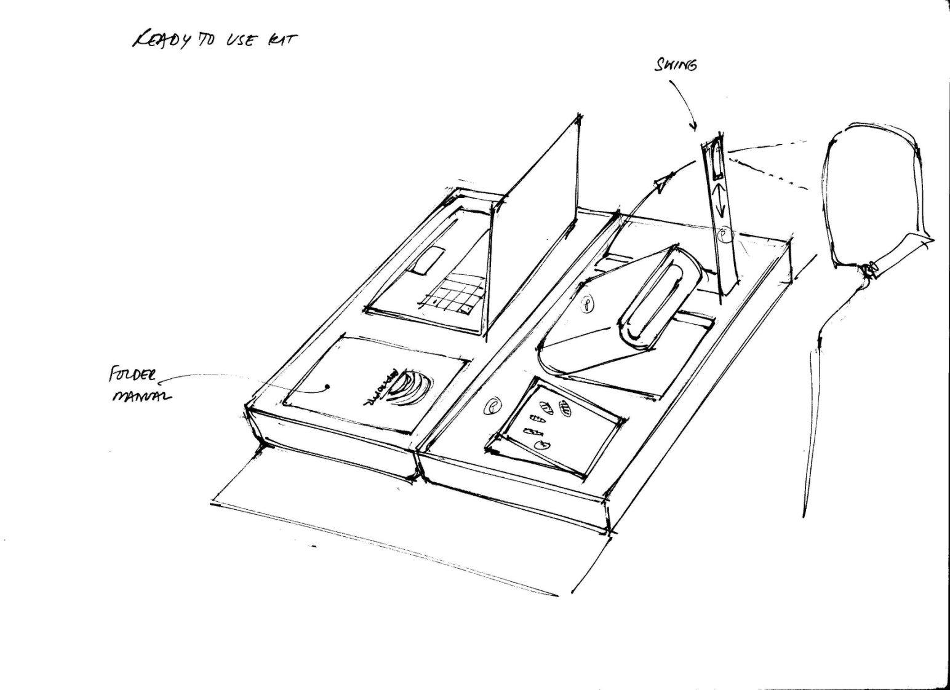
Enrollment Devices Layout - I
Officer
Resident

Slide 9
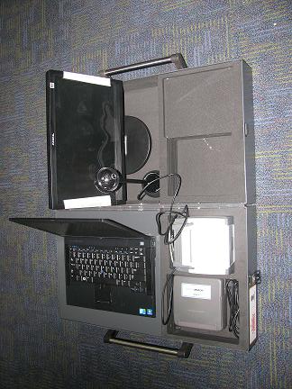
Enrollment Devices Layout -II
Officer
Resident

Slide 10
Enrollment Kit Highlights
Suitcase for Carry all sensitive equipments.
Rugged case
Optimized layout for inbox operation.

Slide 11
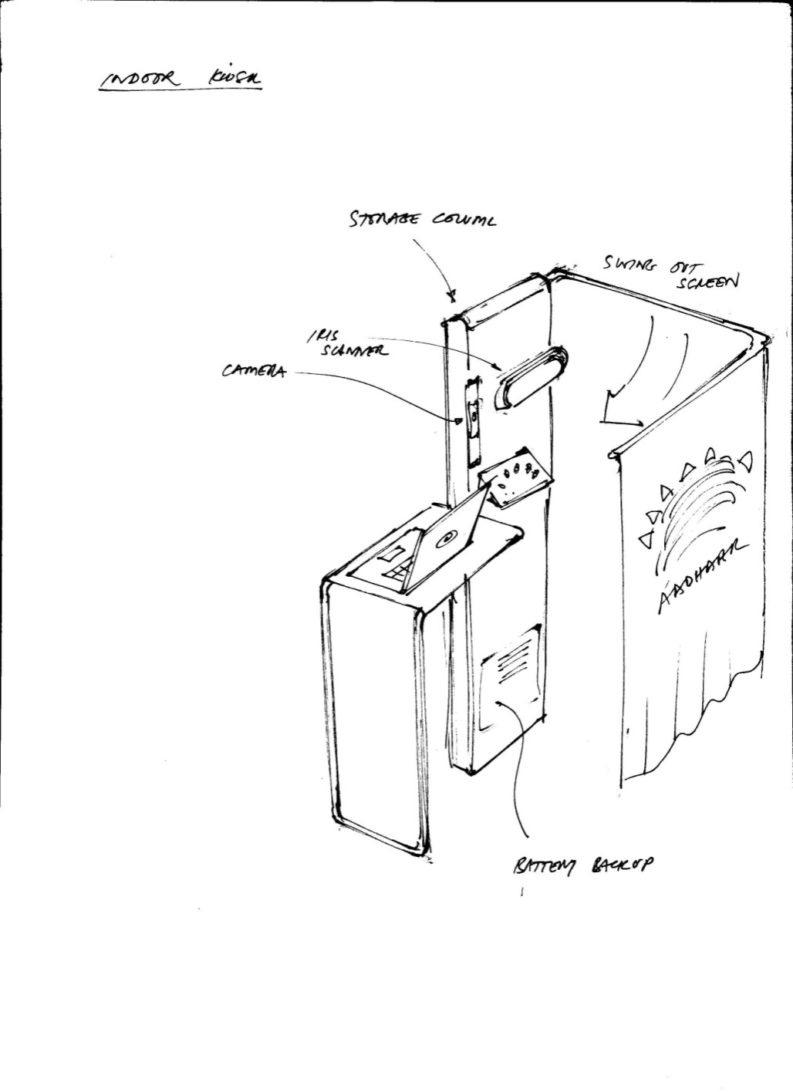
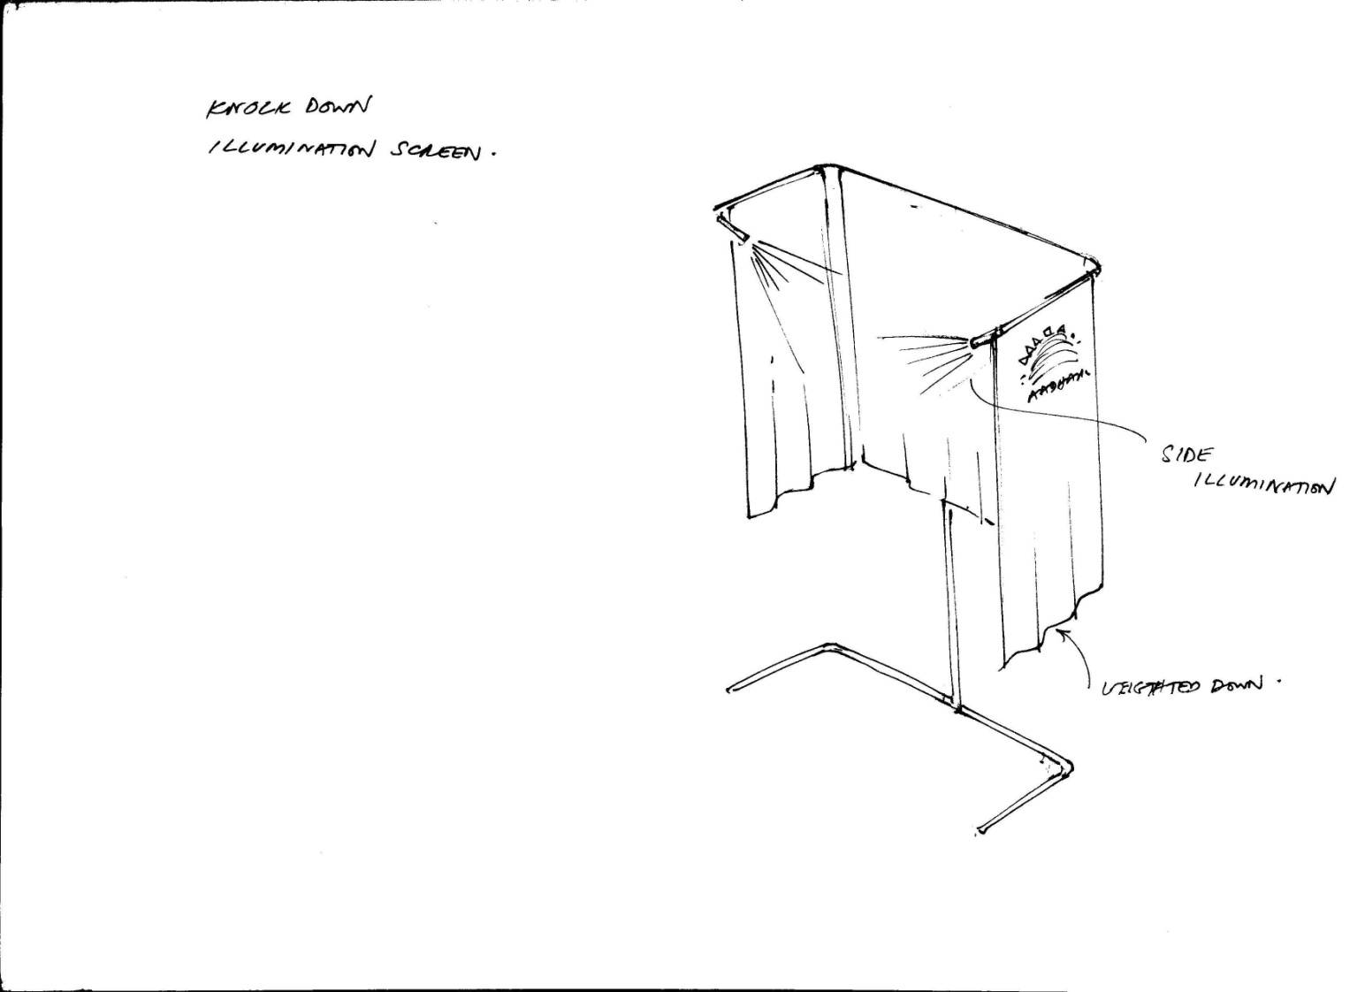
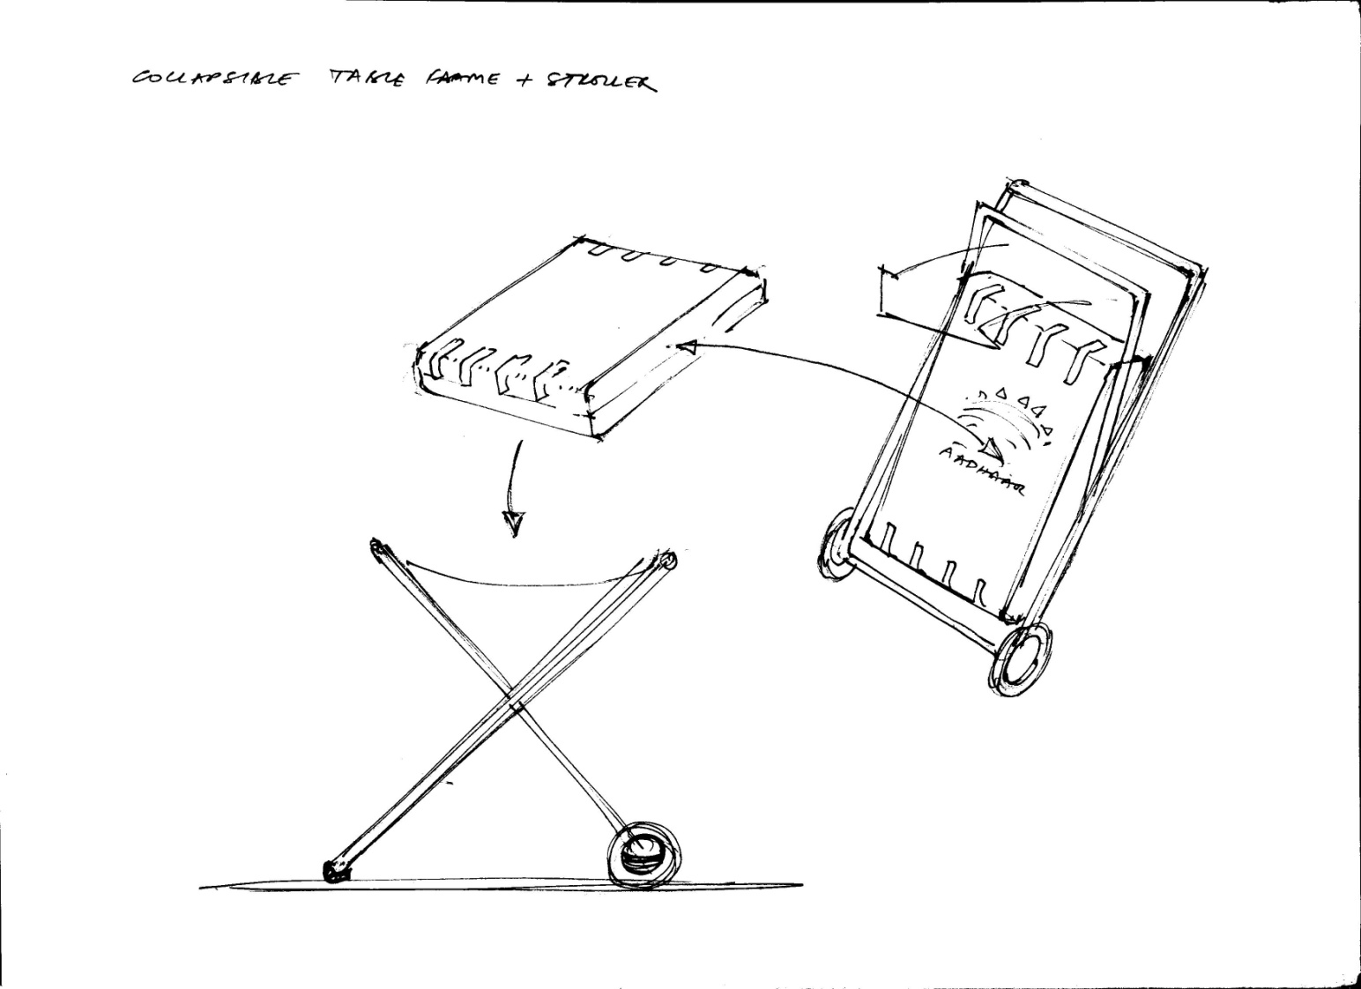
Future Work

Slide 12
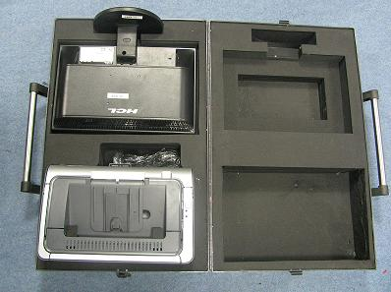
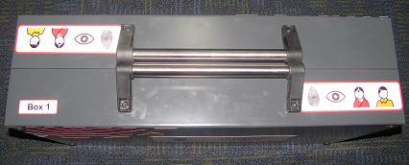
Enrollment Kit- Preview

Slide 13
Enrollment Client Overview

Slide 14
Aadhaar Enrolment Client Software
Product Overview

Slide 15
Enrolment Client Software
A packaged software product provided by UIDAI – currently in version 1.1
A fully productized approach
Fully version controlled
Features mapped to various releases
Bug fixes and patch releases
Automatic Updates
Supported by technical support team
UIDAI will release new versions regularly for continuous update of new features
Features defined by UIDAI
Features requested by users

Slide 16
Product Lifecycle
Product management team creates release plan which continuously updated
Registrar Users
Product Features, Issues, etc.
Release 1
Release 2
Release 3
UIDAI Team
EA Users
Other Users
Version Tree
Bug fixes released as patches and reconciled to main version branch on a continuous basis

Slide 17
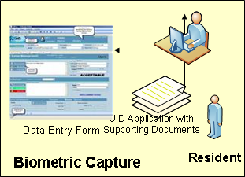
Enrolment Process
CIDR
3
Enrolment
Processing
Biometric
De-duplication
UID Assignment
Biometric
De-duplication
UID Assignment
Letter Delivery & Verification
Enrolment Service
Logistics Partner
(India Post)
Registrar
4
Aadhaar Number
And rejection data
Automatic Synch (software/data)
(Option B)
Enrolment Data
to CIDR
Data Capture
(Option A)
Enrolment Data
to CIDR
2
1
Aadhaar letter or
Rejection letter
2
5
Customer Contact Center
Enrolment
Agency
Information/
Issue resolution

Slide 18
Enrolment Client Features
User Authentication
Role based user authentication and authorization
Application specific login. Users must be pre-registered with CIDR
Pre-Enrolment Support
Capability to upload pre-existing electronic demographic data to enrolment client
Database that may be used for this purpose include PDS, NREGA, RSBY, Passport etc.
Demographic data capture
Textual data entry of the resident based on supportive documents like Proof of Identification/Address (POI/POA)
Basic Transliteration
Conversion of demographic data from English to any Indian official language supported
Language to be converted into is selected as a process of client configuration
Pin code to Region Code mapping
Supports client with master data file to enable correct mapping from pin code to state, district & Village/Town/City

Slide 19
Enrolment Client Features
Local Data Validation
Data validation based on business rules on date of birth, address & relationship
Biometric data capture & quality check
Integration with biometric devices to capture Face, IRIS, and Fingerprint
Vendor neutral quality check to meet quality criteria set by UIDAI
Enrolment Receipt and Acknowledgement Form
Provide resident an enrolment receipt with an enrolment receipt number, date/time & details of data capture
Provide operator a copy of the acknowledgement form signed by resident
Secure data storage and data upload
Secure transfer of data from enrolment client to CIDR through an offline device like memory stick/ optical storage
Automatic Sync with Server
Auto delete of enrolment data at client through online communication with CIDR
Automatic master data and software updates

Slide 20
Aadhaar Authentication Overview
Product Overview

Slide 21
Aadhaar Authentication
Overview

Slide 22
AADAAR Authentication
Answers the question:
“Is resident the person he/she claims to be”

Slide 23
AADAAR Authentication
Authentication(Auth) is a service provided by UIDAI.
Authentication Service establishes identity of residents. (authenticates)
Enrollment is a prerequisite for Authenticating residents. i.e. Auth Service authenticates only enrolled residents.
AADAAR Auth Service is online service..

Slide 24
Authentication
Authentication is a service offered by UID.
Authentication service will be used by various Authenticators.
Authentication Systems will be implemented according to UIDAI specifications by
Authenticators.
Terminal device vendors.

Slide 25
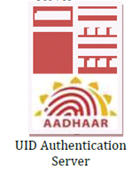
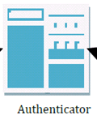
Authentication Flow
Authenticator
Agency
AUA
AADHAAR
Auth
System
Resident
Requests a Service
from service provider
Needs to Verify Identify
Requests for Auth Information
Resident provides UID # and other auth information
Authenticator Requests for Auth Services from UIDAI
UIDAI Verifies the information Provided and replies with Verification
Requested Service is delivered post authentication

Slide 26
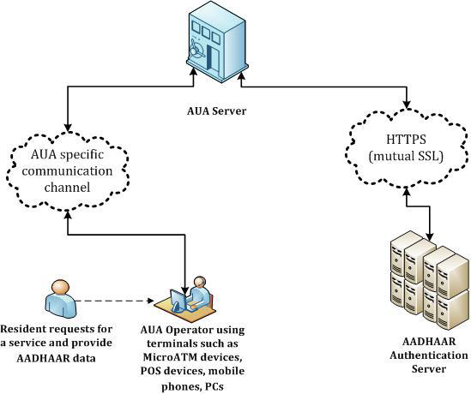
Authentication-Technology View

Slide 27
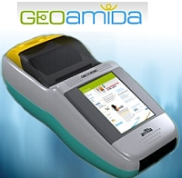
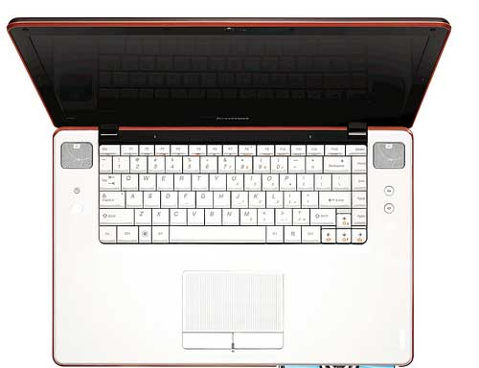
Components of Auth Station
POS Terminal
Mobile phone with Finger
Print Scanner
Finger Print
Scanner
laptop

Slide 28
Authentication API Protocl
Auth is a Stateless service over HTTPS with mutual SSL authentication
Encryption of data at the time of capture
Auth Combination of allowed along with UID are
Biometric
Demographic
As well as PIN/DPIN

Slide 29
Devices used for Authentication
Public Devices
Not Registered with UID
Uses software based security methods recommended by UIDAI
Examples:
Personal computers
Shared computers
Devices on secure networks
Managed Devices
Registered with UID
Managed with keys from UID and AUA.
Implements UIDAI terminal security specs
Examples:
Mobiles
Registered POS Terminals
PC/mobiles

Slide 30
Authentication using Public Devices
UID will provide Auth Client Library for packaging and encrypting auth data block.
Digitally signed UIDAI public key will be provided.
Data block is encrypted using session key using AES-128 algorithm. Session key is encrypted with UID public key.
For public devices, use of OTP recommended.

Slide 31
Next Steps
Questions.
Look out for AADHAAR Auth specification,
UID developer Website
Partner with UID to develop Applications and participate in Pilots.
Notes:
** PIN DPIN concept is complicated
** Provide Usage scenarios for each of these authentication usage models
** Guidelines to Migration to UID system from UID.
** Process..
** Independent mechanism for the Govt agency, to reconcile the actual disbursement and number of authentications provides.
**

Slide 32
Thank You

